Slide 1


Gerardo Cuéllar Bonnard
18/12/2024

Slide 2

Outline
Executive Summary…………………………………………………………….3
Introduction………………………………………………………………………4
Methodology……………………………………………………………………..5
Results…………………………………………………………………………..16
Conclusion………………………………………………………………….......48
Appendix………………………………………………………………………...49

Slide 3
Executive Summary
In this Project we will pull efforts towards an accurate prediction of the Space x Falcon 9 first stage landing , we will use several classification algorithyms to accomplish this.
We will divide our project Into 4 main steps :
Data collection, wrangling, and formatting
Exploratory data analysis
Interactive Data Visualization
Machine learning prediction
Running the classification algorythims shows us that there are correlations between some feature of the rocket launching with the outcome of the launches particulary in success and failure
We have concluded and recommend Decission three as the most efficient and secure way to predict a succesfull landing in the Falcon 9 First Stage.

Slide 4
Introduction
In the race of space, effictiveness is determined by speed and accuracy , the main goal here is to enable the completion and safe return of the first stage of the launch rocket , this will alow us to lower their operational costs and grant a margin within 62 million dollars , this put us in the same page as Space x as a result we separate ourselfs from the rest of the competition and safe our company 103 million dollars .
Most unuccesfull landings tend to be paned , as a result of this Space x plan their ones in the ocean.
To answear the main question will the first stage of the rocket land succesfully/ ? we have review the features corresponding payload mass / orbit type/ Launch site/ and many more

Slide 5

Section 1

Slide 6
Methodology
Executive Summary
Data collection methodology:
SpaceX API / Webscrapping
Perform data wrangling
We process the data , to eliminate missing entries and we encoded categorical features using one - hot encoding / In the end we end up with 90 rows/ instances and 83 columns or features
Perform exploratory data analysis (EDA) using visualization and SQL
Pandas and Numpy: We used Line Charts, Bar Charts , Scatter Plots
Sql/Ipython(Function)/Sqlite

Slide 7
Methodology
Executive Summary
Perform interactive visual analytics using Folium and Plotly Dash
Matplot library and Seaborn
Folium
We used Markers, circles and lines to delimitate the launching areas an their proximity to railroads, highways and main highways within the folium map. A geographical approach was intended for the correct utilization of resources and logistcs.
Dash
Interactive Scatter Plots / Pie Charts
Perform predictive analysis using classification models
How to build, tune, evaluate classification models
Data Frames, Confusion Matrixs
Logistic Regression /SVM/ Decission Three/ KNN

Slide 8
Data Collection – SpaceX API
The Api used is : https://api.spacexdata.com/v4/rockets/
The api provides data about many types of rockets launches done by Space X, the data is therefore filter to include only Falcon 9 Launches
Every missing value in the data is replaced .
We end up with 90 rows or instances and 17 columns or features .
Data Collection Flow Chart
Api Data Source
Space x falcon 9
data
Data Filtering
Missing value Handling
Data Structure ,
(90 row instance, and 17 columns)
Data Collection Github permalink

Slide 9
Data Collection - Scraping
Data is webscrapped from : https://en.wikipedia.org/w/index.php?title=List_of_Falcon_9_and_Falcon_Heavy_launches&oldid=1027686922
The website consist of exclusive falcon 9 Data
We end up with 121 rows and 11 column features
Git hub webScrapping Link
Web
Scrapping
Wikipedia
Page
Data Collection / Scrapping
Flow Chart
Data
Collected
121 Rows
11 columns
Organized
Data Set

Slide 10
Data Wrangling
Data Wrangling Process
We process the data , to eliminate missing entries and we encoded categorical features using one - hot encoding
We then add an extra column called “Class” , this will help us determined if the launch is succesfull or not (1= succesfull landing , 0 = not succesfull landing)
In the end we end up with 90 rows/ instances and 83 columns or features
Data Wrangling Git Hub link
Eliminate Missing entries
Data Cleaning
One-Hot encoding
Feature Encoding
Class Labeling
Adding Class column
90 rows and 83 columns
Final
Dataset

Slide 11
EDA with Data Visualization
Summarize what charts were plotted and why you used those charts
Libraries used for plotting :Pandas and Numpy, were used to delimit information about the data :
We used Scatter point charts , Bar Charts and line plots to :
1.- Determine the relationship between flight number and launch site ,
2.- To observe is there is any relationship between launch sites and their payload mass,
3.-To check if there is any relationship between success rate and orbit type ,
4.-to understand is there is any relationship between Flight number and orbit type.
5.- to reveal the relationship between Payload and orbit type and
6 .-to visualize the lunch success yearly trend
EDA with Visualization Github url

Slide 12
EDA with SQL
Unique launch sites in the space mission
5 records where launch sites begin with the string 'CCA'
Total payload mass carried by boosters launched by NASA (CRS)
Average payload mass carried by booster version F9 v1.1
Date when the first succesful landing outcome in ground pad was acheived.
Names of the boosters which have success in drone ship and have payload mass greater than 4000 but less than 6000
Total number of successful and failure mission outcomes
Names of the booster_versions which have carried the maximum payload mass.
Records which will display the month names, failure landing_outcomes in drone ship ,booster versions, launch_site for the months in year 2015.
Landing outcomes count ranking (such as Failure (drone ship) or Success (ground pad)) between the date 2010-06-04 and 2017-03-20, in descending order.
EDA With Sql Github link
Add the GitHub URL of your completed EDA with SQL notebook, as an external reference and peer-review purpose

Slide 13
Build an Interactive Map with Folium
We used Markers, circles and lines to delimitate the launching areas an their proximity to railroads, highways and main highways, prominent water masses within the folium map. A geographical approach was intended for the correct utilization of resources and logistcs.
Folium , github code

Slide 14
Build a Dashboard with Plotly Dash
We used, interactive Scatter Plots and pie charts , to determine the Launch Succes , the launch success ratio , to efectively understand the correlationship , between payload and Launch Succes.
Dash Github url Link

Slide 15
Predictive Analysis (Classification)
We used and fit 4 classification algorithyms : Logistic Regression , SVM, Decission Tree and KNN into confussion Matrixes , to determine the most effective one, to accomplish the safe return of the Falcon 9 first Stage Landing .
Confussion matrixes
results
Logistic Regression
SVM
Predictive Analytic models
Fit with data
Decission Tree
(the most effective one)
Decission Tree
KNN
Predictive analytics Classification GitHub URL of your

Slide 16
Results
Exploratory data analysis results
Interactive analytics demo in screenshots
Predictive analysis results

Slide 17

Section 2

Slide 18
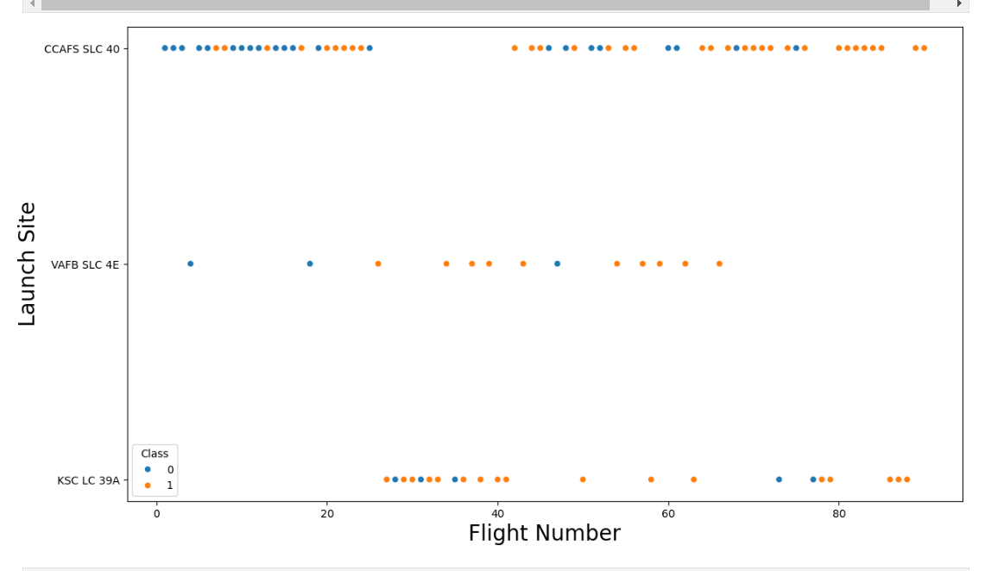
Flight Number vs. Launch Site
This scatter plot shows us the correct relationship between fight number in the x axis and Launch site in y axis. The class is represented in 0 and1 , 0 being an unsuccesfull launch and 1 representing a succesfull launch .

Slide 19
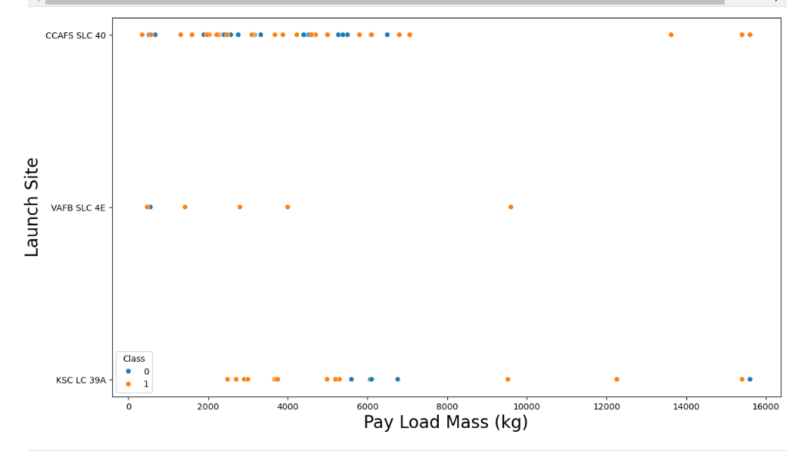
Payload vs. Launch Site
This scatter plot shows us the correct relationship between Payload mas in the x axis and Launch site in y axis. The class is represented in 0 and1 , 0 being an unsuccesfull launch and 1 representing a succesfull launch . Its interesting to denote that 8000 kg does not have a launch attempt .

Slide 20
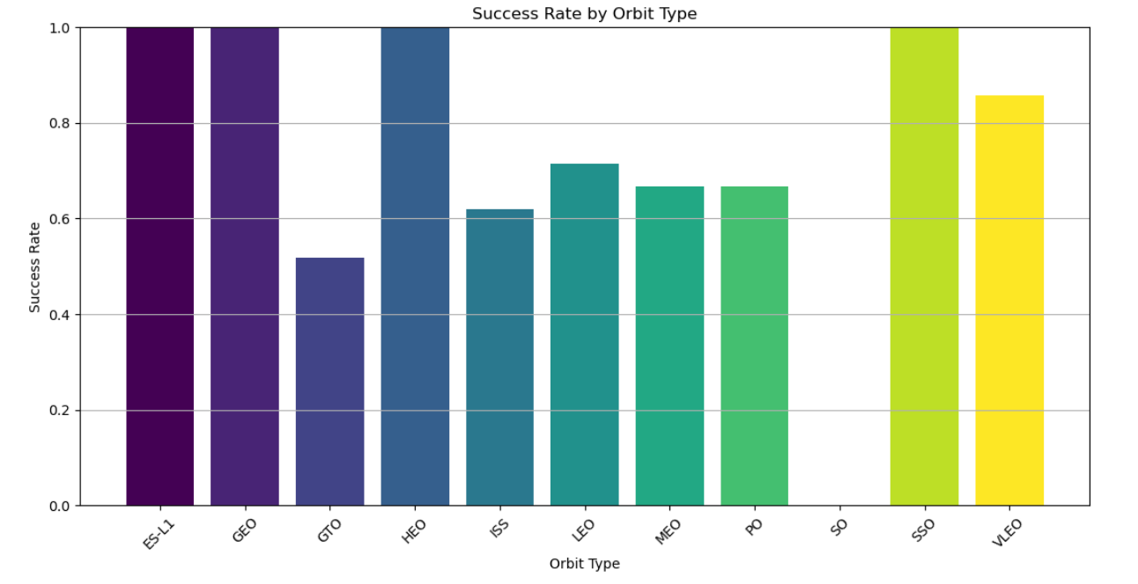
Success Rate vs. Orbit Type Bar Chart

Slide 21
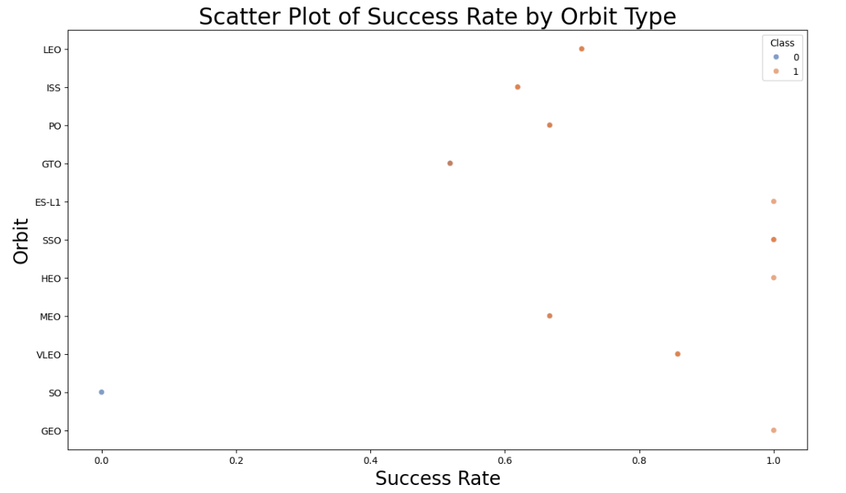
Success Rate vs. Orbit Type Scatter Plot
With this analysis we can understand insights of wich orbit types are more reliable in their performance x axis represents , success rate and y axis represents Orbit

Slide 22
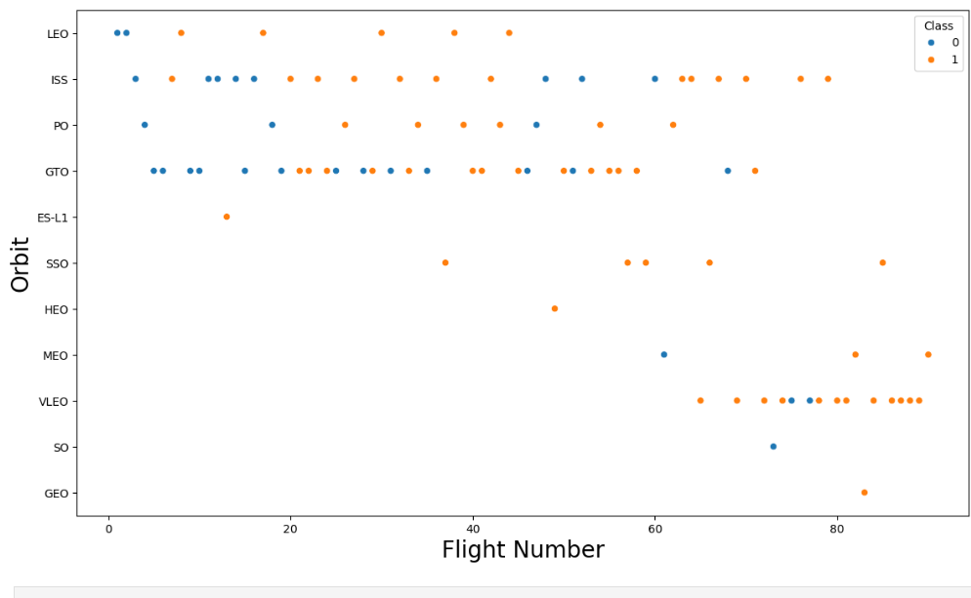
Flight Number vs. Orbit Type
This scatter plot shows us the relationship between Flight number in the x axis and Orbit site in y axis. The class is represented in 0 and1 , 0 being an unsuccesfull launch and 1 representing a succesfull launch .

Slide 23
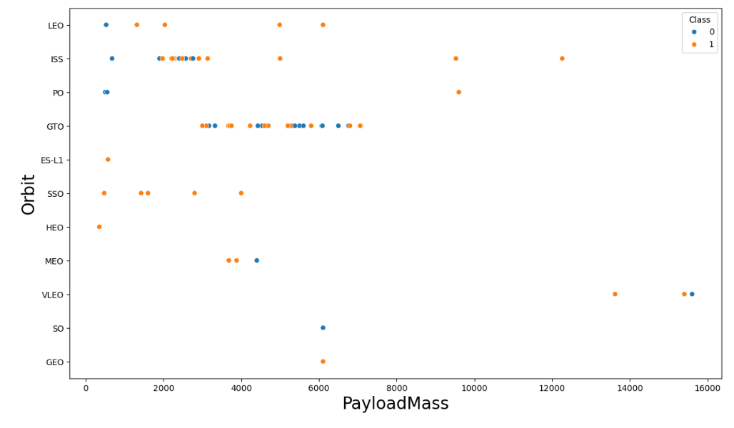
Payload vs. Orbit Type
This scatter plot shows us the correct relationship between Payload mas in the x axis and orbit in y axis. The class is represented in 0 and1 , 0 being an unsuccesfull launch and 1 representing a succesfull launch . Its interesting to denote that 8000 kg does not have a launch attempt .

Slide 24
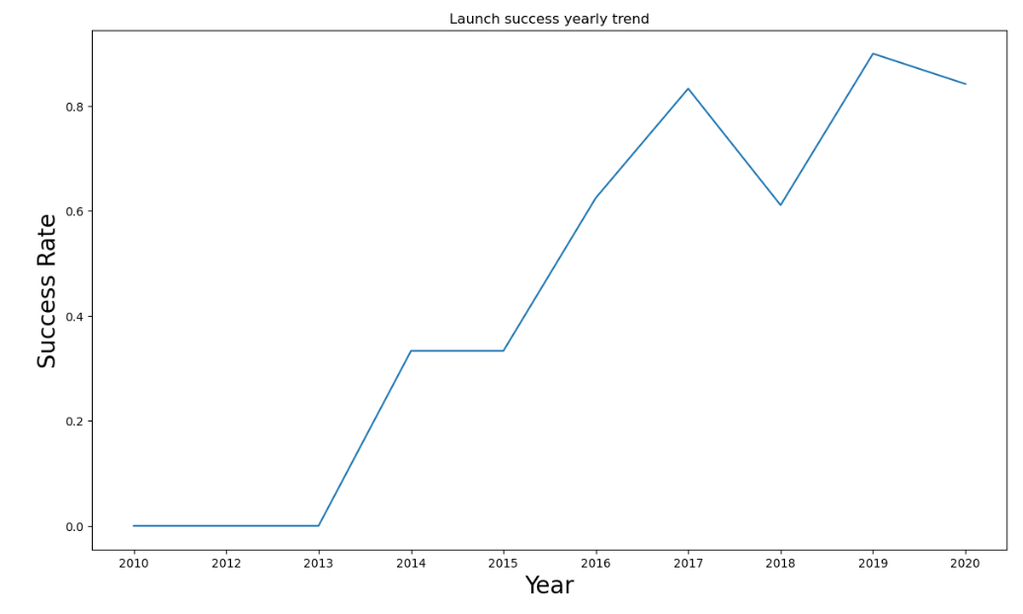
Launch Success Yearly Trend
This Line cahrt , show us , the relationship , betweenYear in the x Axis and the success rate in the Y axes . Having and constant grow since 2010 with a considerable drop in 2018 , the highest relationship rate is found between 2018 and 2019 , with a minor drop in 2020 , probably due to Covid 19

Slide 25
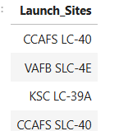

All Launch Site Names
This sql code Display the names of the unique launch sites in the space mission.

Slide 26
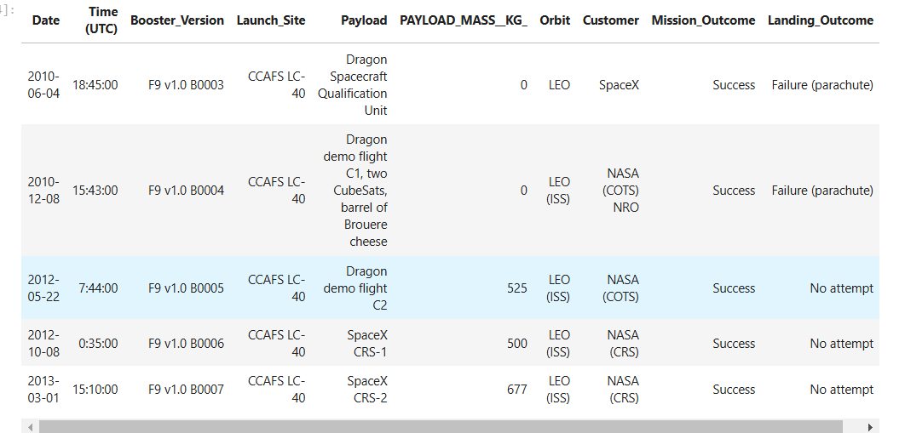

Launch Site Names that Begin with 'CCA'
This sql code displays 5 records where launch sites begin with ‘CCA’

Slide 27
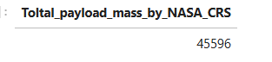

Total Payload Mass
This Sql Code calculates the total payload by boosters From NaSA

Slide 28
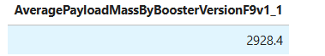
Average Payload Mass by F9 v1.1
%sql SELECT AVG(PAYLOAD_MASS__KG_) AS AveragePayloadMassByBoosterVersionF9v1_1 FROM SPACEXTBL WHERE BOOSTER_VERSION = 'F9 v1.1';
This Sql code Calculates the average payload mass carried by booster version F9 v1.1

Slide 29

First Successful Ground Landing Date
%sql SELECT MIN(DATE) AS 'Date of first successful landing outcome in ground pad' FROM SPACEXTBL WHERE LANDING_OUTCOME = 'Success (ground pad)';
This sql code finds and display the the dates of the first successful landing outcome on ground pad

Slide 30
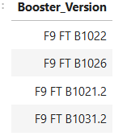
Successful Drone Ship Landing with Payload between 4000 and 6000
%sql SELECT BOOSTER_VERSION FROM SPACEXTBL WHERE LANDING_OUTCOME = 'Success (drone ship)' AND PAYLOAD_MASS__KG_ BETWEEN 4000 AND 6000;
This sql code lists the names of boosters which have successfully landed on drone ship and had payload mass greater than 4000 but less than 6000

Slide 31
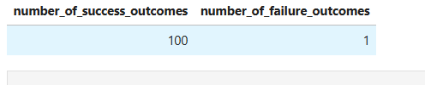
Total Number of Successful and Failure Mission Outcomes
%sql SELECT number_of_success_outcomes, number_of_failure_outcomes FROM (SELECT COUNT(*) AS number_of_success_outcomes FROM SPACEXTBL WHERE MISSION_OUTCOME LIKE 'Success%') success_table, (SELECT COUNT(*) number_of_failure_outcomes FROM SPACEXTBL WHERE MISSION_OUTCOME LIKE 'Failure%') failure_table
This Sql code Calculates and displays the total number of successful and failure mission outcomes

Slide 32
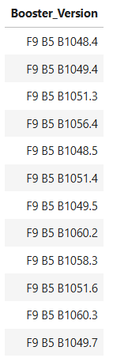

Boosters Carried Maximum Payload
This sql code lists the names of the booster which have carried the maximum payload mass

Slide 33
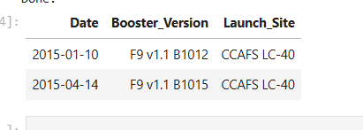
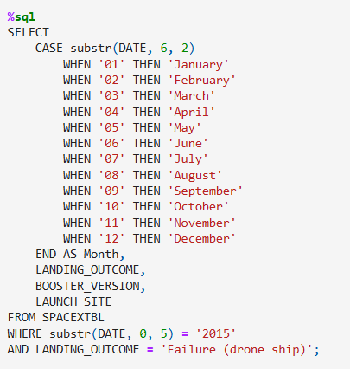
2015 Launch Records
This Sql Lists the failed landing_outcomes in drone ship, their booster versions and launch site names for year 2015

Slide 34
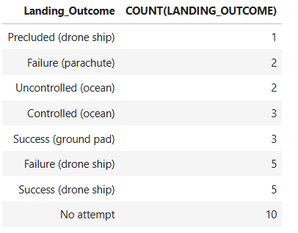
Rank Landing Outcomes Between 2010-06-04 and 2017-03-20
%sql SELECT LANDING_OUTCOME, COUNT(LANDING_OUTCOME) FROM SPACEXTBL WHERE DATE BETWEEN '2010-06-04' AND '2017-03-20' GROUP BY LANDING_OUTCOME ORDER BY COUNT(LANDING_OUTCOME);
This sql Ranks and displays the count of landing outcomes (such as Failure (drone ship) or Success (ground pad)) between the date 2010-06-04 and 2017-03-20, in descending order

Slide 35

Section 3

Slide 36
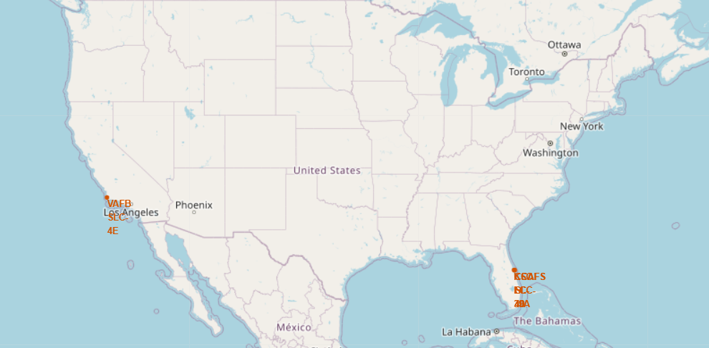
Launch site delimitation
We have delimited the Launch sites,
Knowing these we have a proper understanding of the area and their surroundings

Slide 37
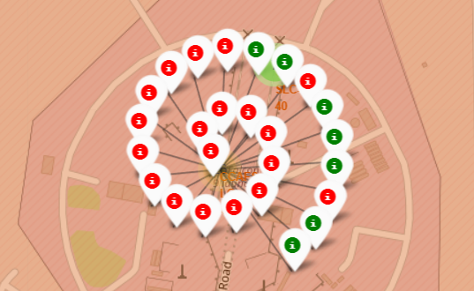
<Proper outcome and failure color launches>
In here we can see an example of the Launch , represented by “Child markers”,
(Succesfull in green , unsucsesfull in red.) It os important because it gives us a visual representation of each launch

Slide 38
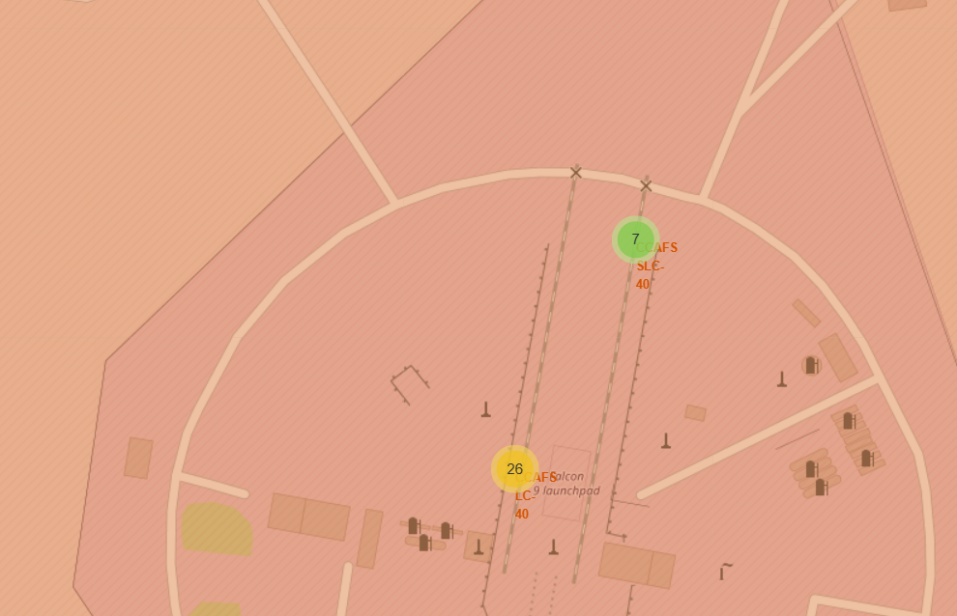
<Railway proximity example>
In here we can see two launch sites , wich are close to railroads . A geographical understanding of the sorroundings allow us to make a proper analyses considering the correct utilization of resources and logistcs.

Slide 39

Section 4

Slide 40
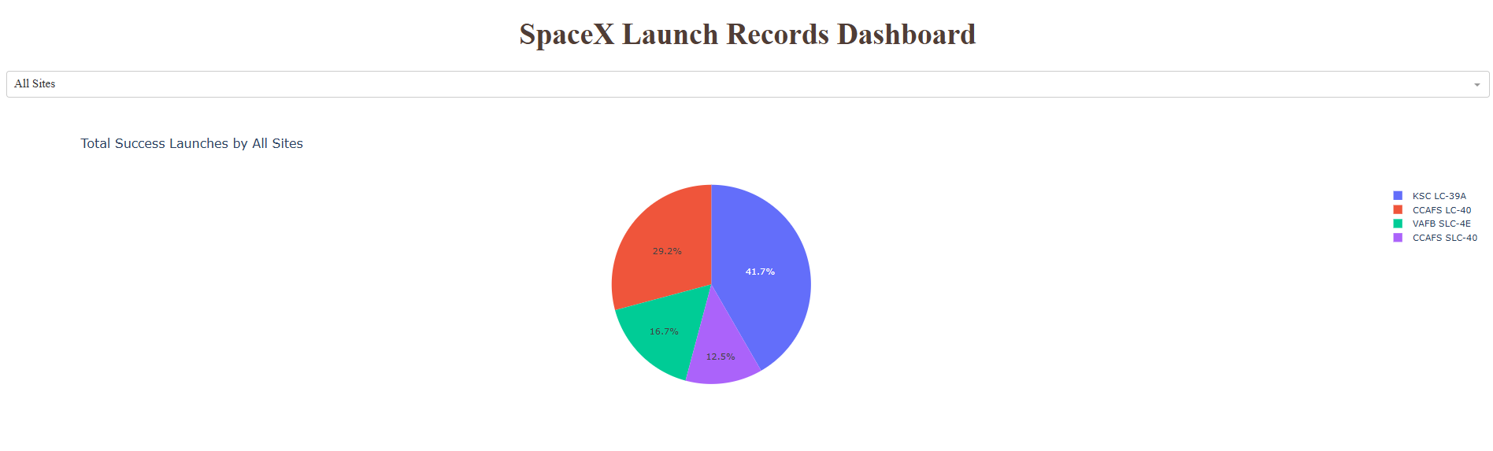
<Launch success Pie Chart>
This here represents the Launch success Pie Chart for all sites, divided in 29.2% (CCAFS LC 40 launch site in color red) 41.7% (KSC LC-39A in color blue), 12.5%(CCAFS SLC-4E in color purple) , 16.7% (VAFB SLC-4E in color green)

Slide 41
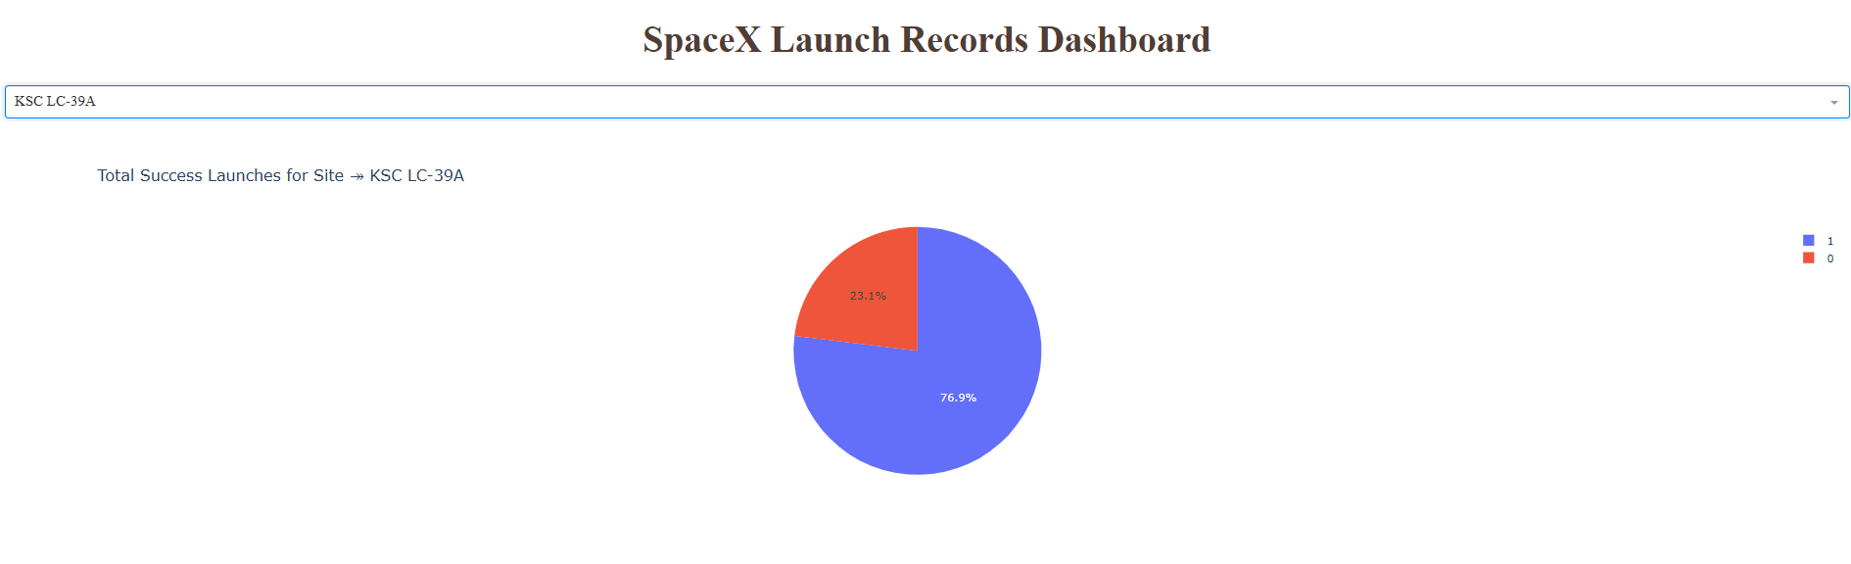
<Highest launch success ratio>
Here we can see that the highes launch success ratio , was found in KSC LC-39A . With an astonishing 76.9% succesfull rate

Slide 42
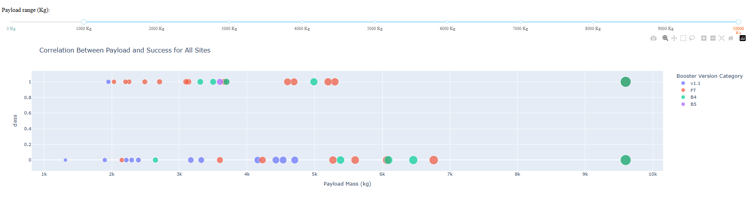
<Correlation between Payload and Launch Success >
In this scatter point plot we can see that between the range of 1000 kg to 10.000kg ‘ft’ booster version that the highesst rate. V1.1 and b5 booster version being the lowest

Slide 43
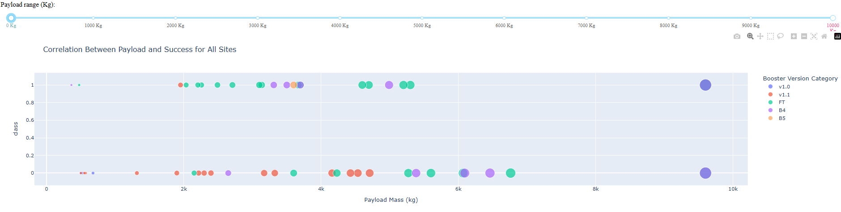
<Correlation between Payload and Launch Success >
In this scatter point plot ,we can see that between the range of 0 kg to 10.000kg ‘ft’ booster version has the highess success rate. ‘v1.1’ and ‘b5’ booster versions being the lowest .

Slide 44
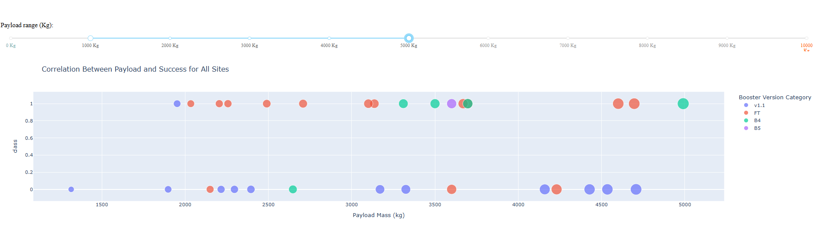
<Correlation between Payload and Launch Success >
In this scatter point plot ,we can see that between the range of 1000 kg to 5000kg ‘ft’ booster version has the highest success rate. ‘v1.1’ and ‘b5’ booster versions being the lowest .

Slide 45

Section 5

Slide 46
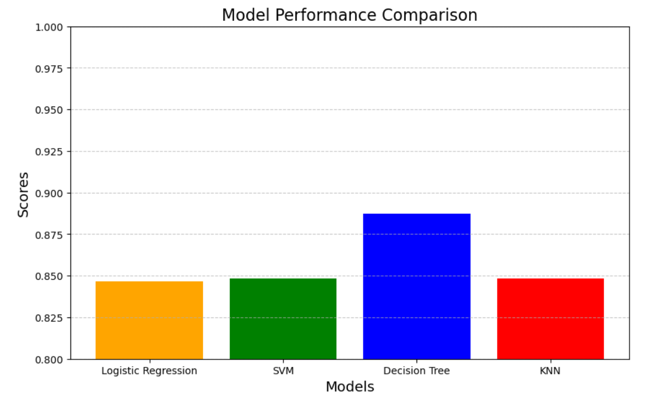
Classification Accuracy

Slide 47
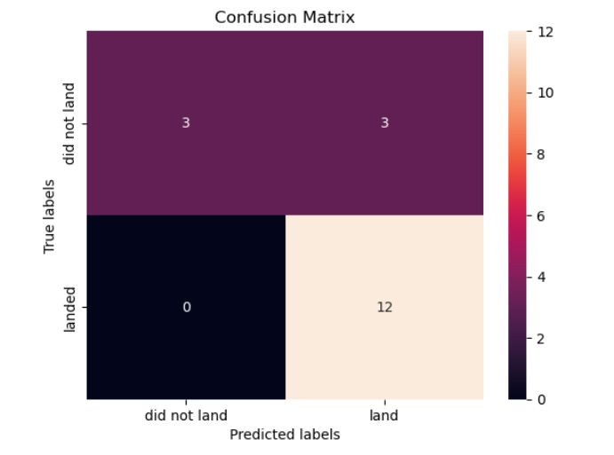
Confusion Matrix
Best confusion matrix performing: Decission Tree
Model with an explanation
Decion tree predictive model , give us the higer success Rate performance in determine of wheter or not we have completion and safe return of the first stage of the launch rocket. This confussion Matrix is proof of that.

Slide 48
Conclusions
In this project, we try to predict the landing outcome of a given falcon 9 launch in order to determine its cost and implement the same system to reduce operational costs, and win the space race
We have consider each feature of the Falcon 9 Launch and determine that they individually and collectively have an affect in the mission. Therefore its importance of the analys .
We employed several machine learning algorythims to learn patterns In data of past falcon 9 launches, this in order to produce predictive models that can produce the dessired outcome of a falcon 9 Launch.
We have concluded that best predictive model by Decission tree perform the best among the 4 machine learning algorythims.

Slide 49
Appendix
Raw codes/Queries can be found in the determine links :
Data Collection Github permalink
Git hub webScrapping Link
Data Wrangling Git Hub link
EDA with Visualization Github url
EDA With Sql Github link
Folium , github code
Dash Github url Link
Predictive analytics Classification GitHub URL of your

Slide 50
Appendix / Additional Charts with code links
Scatter Plot of Succes Rate vs Orbit type github url link
Model Performance Bar Chart, github Codes

Slide 51
Appendix / Local ( power point) Flow Charts
Data Collection Flow Chart
Api Data Source
Space x falcon 9
data
Data Filtering
Missing value Handling
Data Structure ,
(90 row instance, and 17 columns)

Slide 52
Appendix / Local ( power point) Flow Charts
Web
Scrapping
Wikipedia
Page
Data Collection / Scrapping
Flow Chart
Data
Collected
121 Rows
11 columns
Organized
Data Set

Slide 53
Appendix / Local ( power point) Flow Charts
confusion matrixes
results
Logistic Regression
SVM
Predictive Analytic models
Fit with data
Decission Tree
(the most effective one)
Decission Tree
KNN

Slide 54


